Slide 1
Sushma Rangisetti
Step Presentation
Group B Project

Slide 2
Initial Analysis:
I have analysed the data by comparing the Target,Code_Gender,Years_BeginExpluatation_Avg.
Target represents whether the fraud is committed or not.where as, Code_Gender repersents the gender of the client.
Years_BeginExpluatation_Avg denotes Normalized information about building where the client lives.

Slide 3
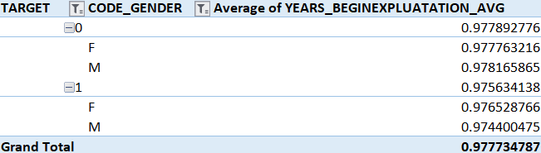
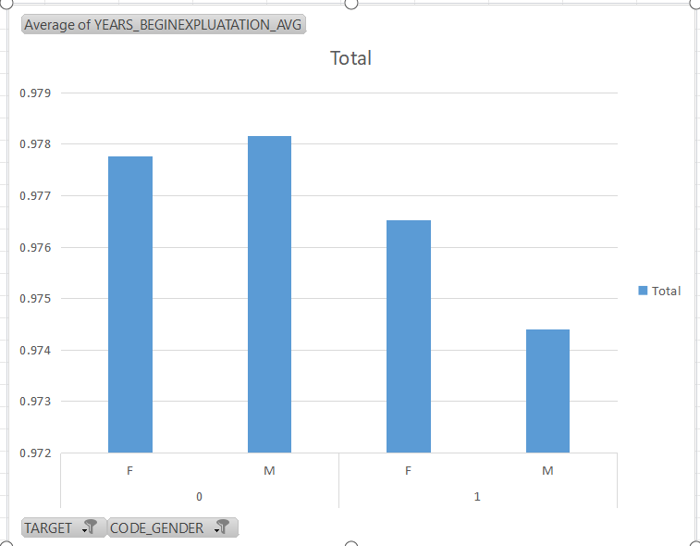
Conclusion:
The correlation between the variables Target and Years_BeginExpluatation_avg is almost near to zero i.e., -0.0097 which represents that there is no linear relationship between these two variables.
Later,I have included Code_Gender to compare the result.The graph shows that,there is a very slight difference between the male and female clients who were faruded.
It is better to include variables which has a correlation with the Target to do more analysis on the provided data.

